Slide 1
Social network mining
- Elaboration -
Projeto de Informática
Grupo 2

Slide 2
Goals
Bots that Mimic Human behavior in order to enter private communities
Deceive Social Networks to believe that it is a human interacting
All decisions are made by a control center
Bots must be the most ”Stateless” as possible

Slide 3
Goals
Store all information on a Graph oriented Database
Visualization tools for Graphs

Slide 4
Requirements gathering
To better meet our problem and gather all requirements necessary we gathered information with our stakeholder (Diogo Gomes) in the several meetings with him and by brainstorming.

Slide 5
Client
Our final client is an:
Investigator

Slide 6
State of the Art
Simulate Human Behaviors in social networks such as Time Needed to Read text, interact with users (like, share/retweet, reply, follow), not follow a schedule or each others, …
Use TOR to keep away social networks to find out patterns from bot’s behaviors
(ex: log in all from same location and time)
All Bot’s decisions are made by a control center making it easy to add and remove bots in case of need (ex: being Banned)

Slide 7
State of the Art
All gathered data will be stored in Neo4J
A customizable web interface will be made in order to display gathered data.
No Authentication is needed

Slide 8
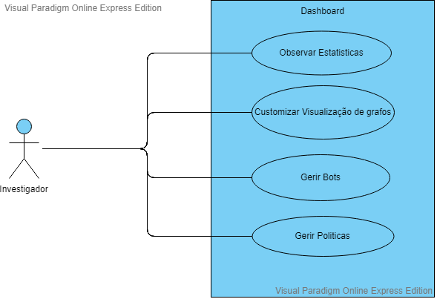
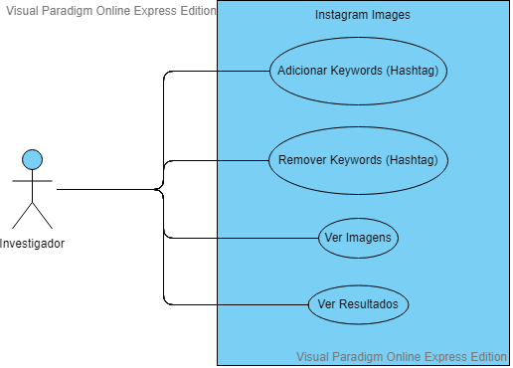
Use Cases

Slide 9
Functional Requirements
View the Network
Customizable System
Identify Communities
Visualization Tools

Slide 10
Non-Functional Requirements
Usability
Interoperability
Scalability

Slide 11
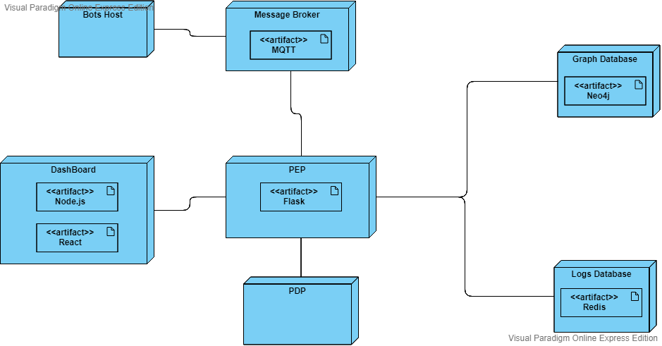

Slide 12
